Slide 1
Topic: Key managerial roles and skills
Dr. C. Vijaya Banu
Professor , School of Management
SASTRA Deemed University, Thanjavur – 613 401
vijayabanu@mba.sastra.edu

Slide 2
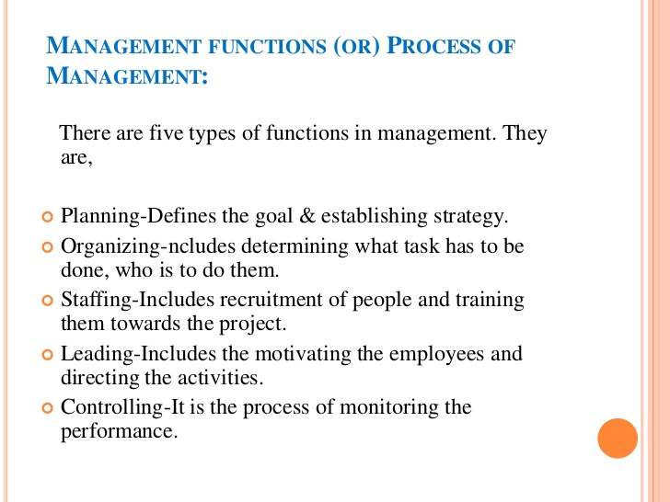

Slide 3
What Managers Do?
Roles Manager’s Play
Roles are specific actions or behaviors expected of a manager.
Mintzberg identified 10 roles grouped around interpersonal relationships, the transfer of information, and decision making.

Slide 4
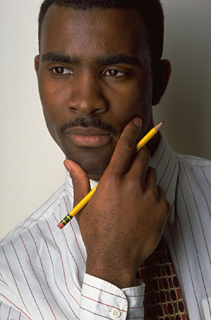
What Managers Do (Mintzberg)
Actions
thoughtful thinking
practical doing
Action oriented

Slide 5
What Managers Do?
Management Roles (Mintzberg)
Interpersonal roles
Figurehead, leader, liaison
Informational roles
Monitor, disseminator, spokesperson
Decisional roles
Entrepreneur, disturbance handler, resource allocator, negotiator

Slide 6
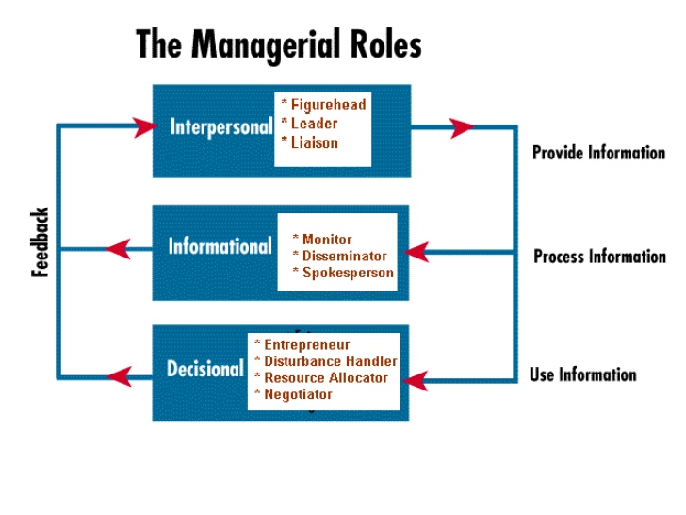

Slide 7
INTERPERSONAL
Role | Description | Identifiable Activity
Figurehead | Manager serves as an official representative of the organization or unit | Greeting visitors; signing legal documents
Leader | Manager guides and motivates staff and acts as a positive influence in the workplace | Staffing, training
Liaison | Manager interacts with peers and with people outside the organization to gain information | Acknowledging mail/email; serving on boards; performing activities that involve outsiders

Slide 8
INFORMATIONAL
Role | Description | Identifiable Activity
Monitor | Manager receives and collects information | Reading magazines and reports; maintaining personal contacts
Communication (Disseminator) | Manager distributes information within the organization | Holding meetings; making phone calls to relay information; email/memos
Spokesperson | Manager distributes information outside the organization | Holding board meetings; giving information to the media

Slide 9
DECISIONAL
Role | Description | Identifiable Activity
Entrepreneur | Manager initiates change | Organizing sessions to develop new programs; supervises design of projects
Disturbance Handler | Manager decides how conflicts between subordinates should be resolved | Steps in when an employee suddenly leaves or an important customer is lost
Resource Allocator | Manager decides how the organization will use its resources | Scheduling; requesting authorization; budgeting
Negotiator | Manager decides to negotiate major contracts with other organizations or individuals | Participating in union contract negotiations or in those with suppliers

Slide 10
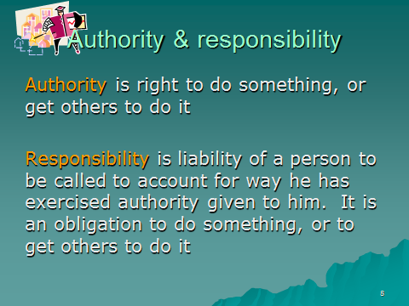

Slide 11
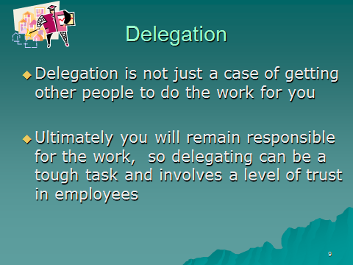

Slide 12
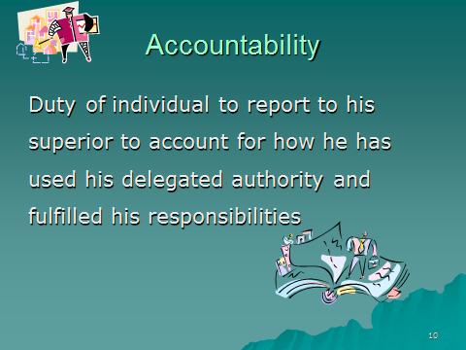

Slide 13
What Managers Do?
Skills Managers Need
Technical skills
Knowledge and proficiency in a specific field
Human skills
The ability to work well with other people
Conceptual skills
The ability to think and conceptualize about abstract and complex situations concerning the organization

Slide 14
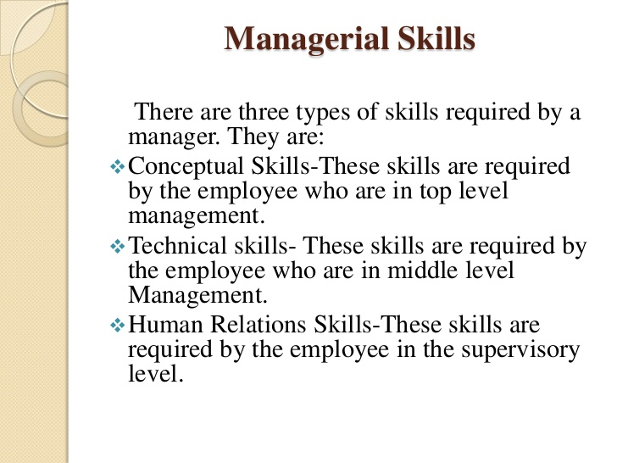

Slide 15
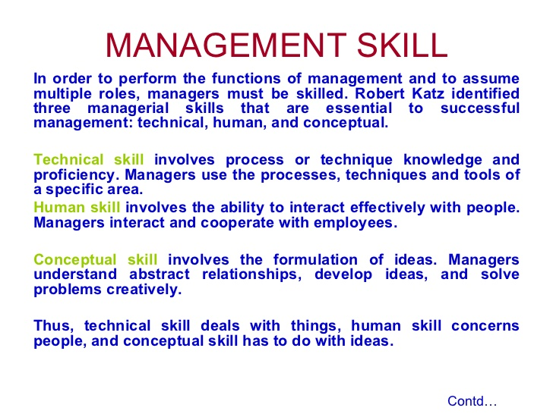

Slide 16
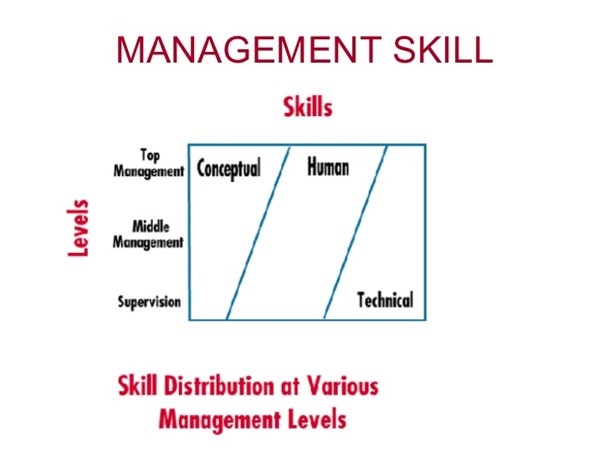

Slide 17
Political skills
The ability to enhance one’s position, build a power base, establish connections, acquire resources for the business.

Slide 18
How The Manager’s Job Is Changing
The Increasing Importance of Customers
Customers: the reason that organizations exist
Managing customer relationships is the responsibility of all managers and employees.
Consistent high quality customer service is essential for survival.
Innovation
Doing things differently, exploring new territory, and taking risks
Managers should encourage employees to be aware of and act on opportunities for innovation.
Blue ocean strategy

Slide 19
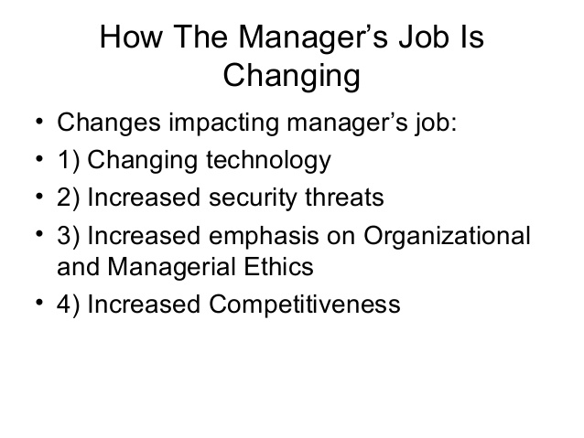

Slide 20
Vision Mission Values

Slide 21
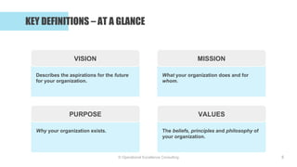

Slide 22


Slide 23
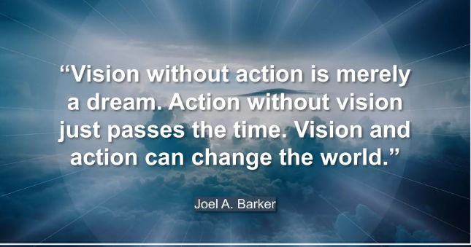

Slide 24
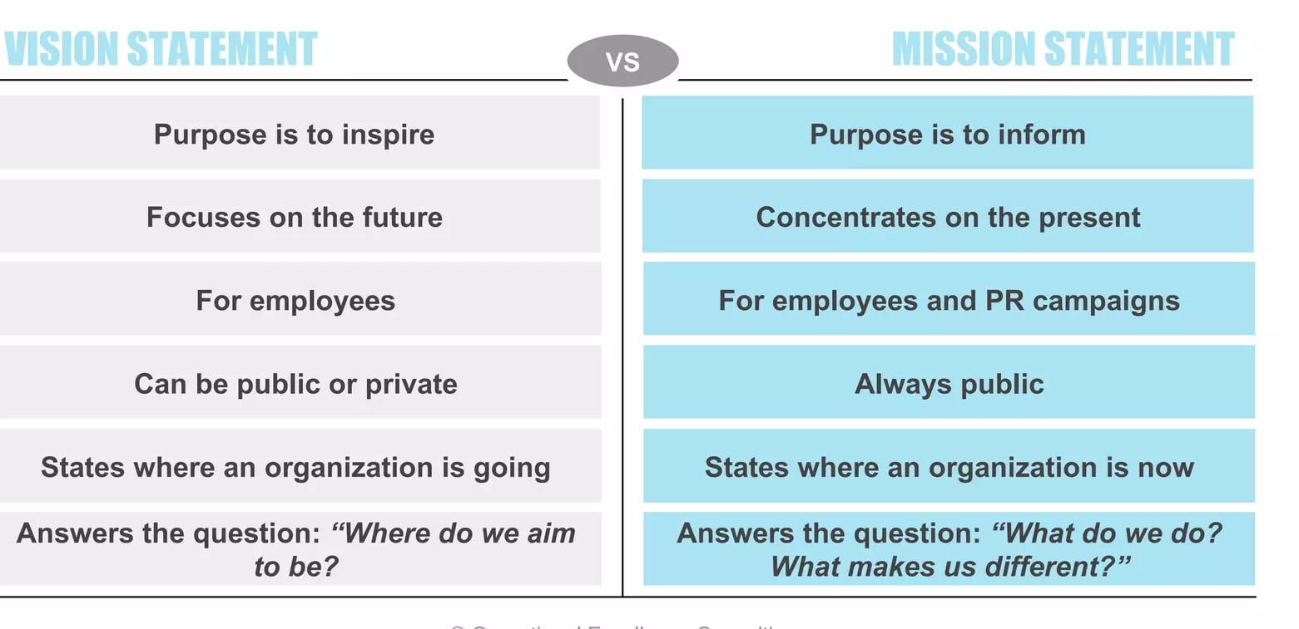

Slide 25
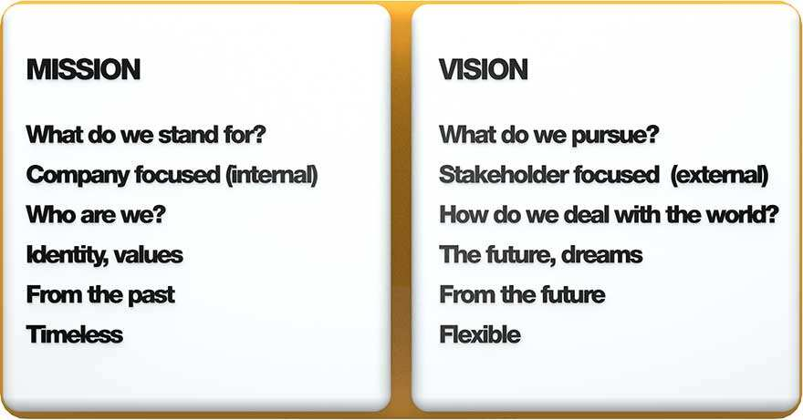
Difference

Slide 26



Vision and Mission

Slide 27


Slide 28
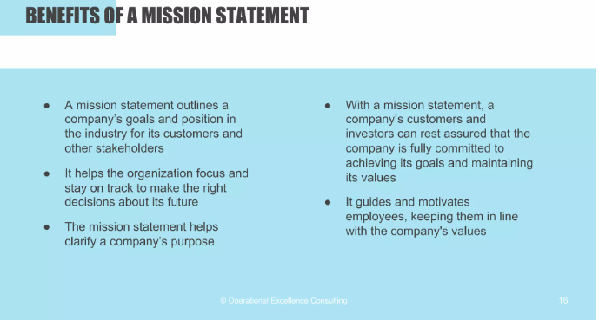

Slide 29
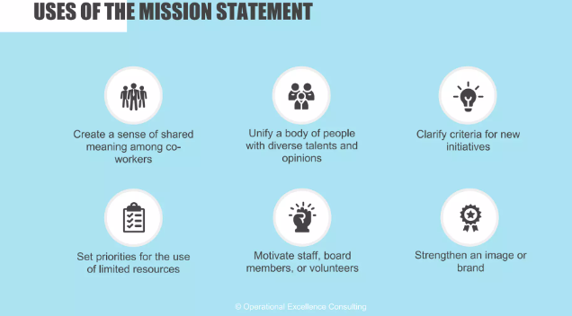

Slide 30
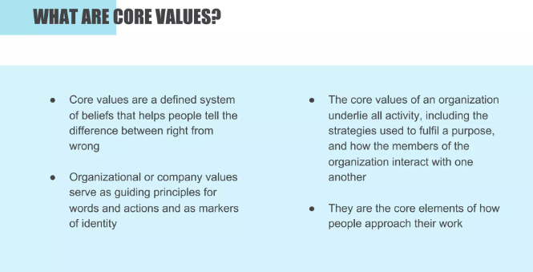

Slide 31
